Slide 1
SUPERVISOR:
SAHAR ARSHAD
INTERNS:
EMAAN BASHIR
MAARIJ KHAN
HASSAN BIN ALI
AMNA AHMAD

Slide 2
RESUME CLASSIFICATION
EMAAN BASHIR (BESE-10A)
https://drive.google.com/drive/folders/19M2GwmJmUZP78kNBjftd8_CLInvVjgAK?usp=sharing

Slide 3
WORK SUMMARY TILL MID-WEEK
Completed fast.ai lectures
Completed Stanford university course
Practiced different libraries including pytorch, pandas, nltk and scikit-learn
Started work on resume classification model
Objectives achieved
Basics of Machine Learning and Deep Learning covered
Basics of NLP covered
Text pre-processing tasks covered

Slide 4
RESUME CLASSIFICATION
Classify Resumes on the basis of occupational categories
Different steps for training the resume classification model:
Resume dataset
Data pre-processing
Vectorizing data
Encoding categories
Train-test split
Training the classifier
Classify a resume

Slide 5
RESUME CLASSIFICATION
Get a Dataset
Pre - process Data
Vectorize Data
Encode Categories
Train - Test Split
Train the Classifier
Classify a resume

Slide 6
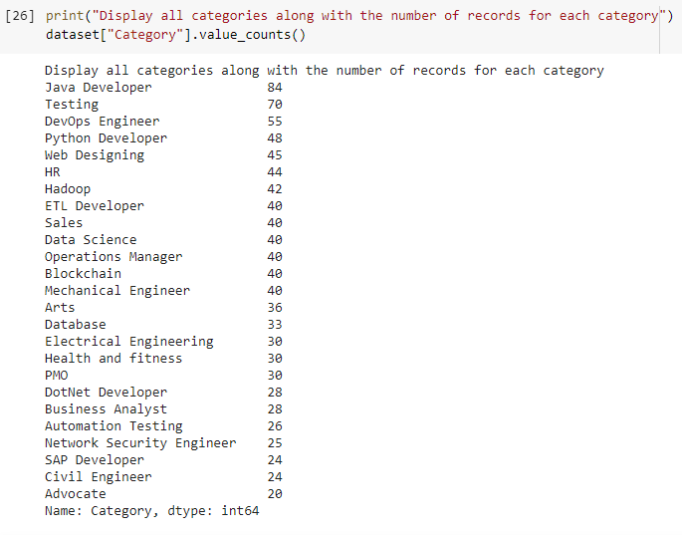
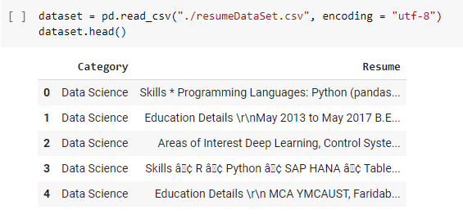
RESUME DATASET
962 different resumes
25 unique categories
https://www.kaggle.com/gauravduttakiit/resume-dataset

Slide 7
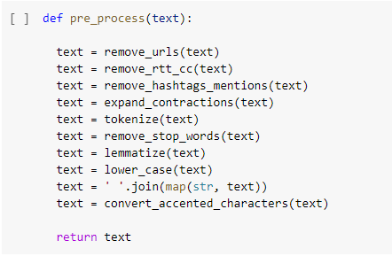
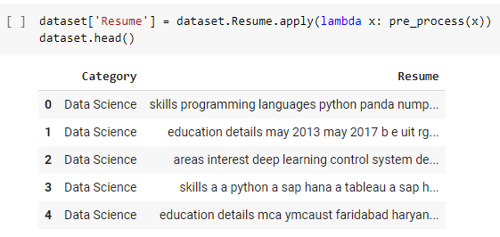
PRE-PROCESSING
Perform some pre-processing on the dataset to obtain cleaned data
Tokenization and Remove punctuation
Remove stop words
Lemmatization
Convert to lower case
Removal of urls
Conversion of accented characters
Removal of hashtags and mentions
Expand contractions

Slide 8
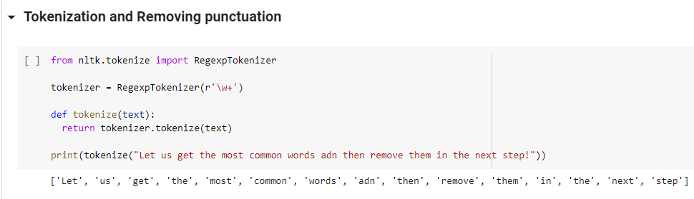
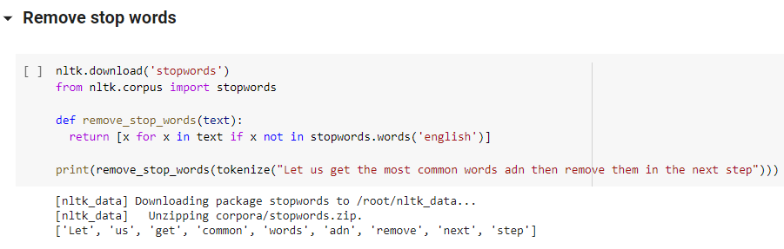
TEXT PRE-PROCESSING
Tokenization
Break raw text into words called tokens
Remove punctuation
Remove all punctuation marks
Remove stop words
Remove all commonly used words e.g the, a, is etc

Slide 9
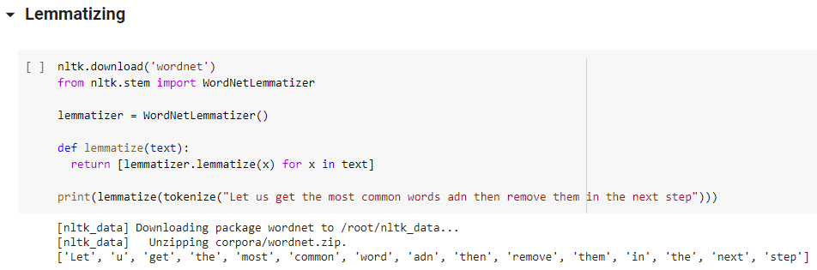
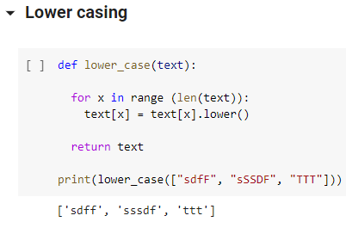
TEXT PRE-PROCESSING
Lemmatization
A method that switches any kind of word to its base root word.
e.g running is replaced by run
Lower case
Convert the text into lower case

Slide 10
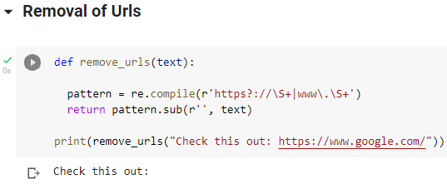
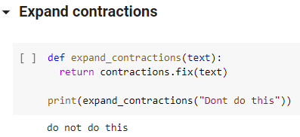
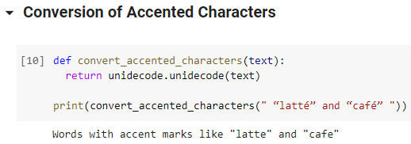
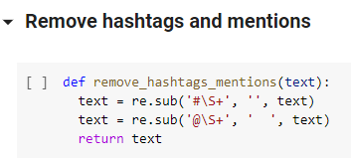
TEXT PRE-PROCESSING

Slide 11
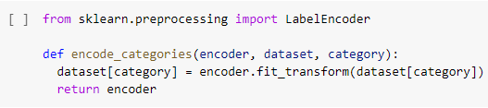
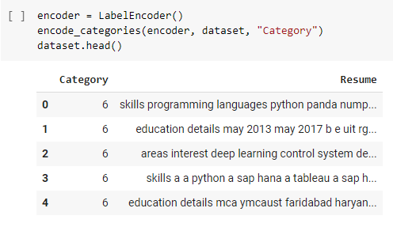
ENCODE CATEGORIES
Use the Label Encoder to encode each category
Represent each unique category with a numerical digit

Slide 12
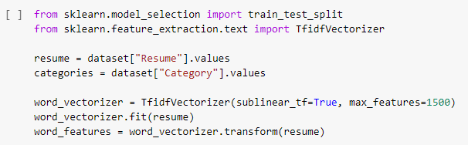
VECTORIZE DATA
Convert each resume into a vector using TfidVectorizer
The TfidVectorizer
Tokenizes documents
Learns the vocabulary
Inverse document frequency weightings
Allows to encode new documents

Slide 13
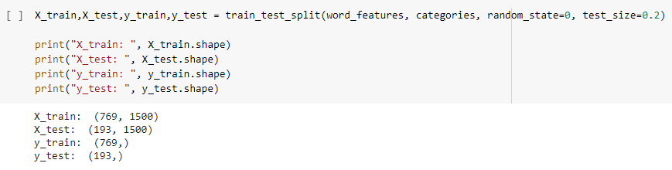
TRAIN-TEST SPLIT
Split the data into train and test sets
Test set contains 20% of the data
Train set: 769 resumes
Test set: 193 resumes

Slide 14
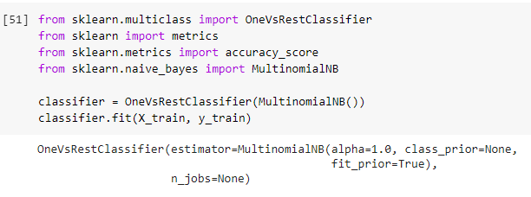
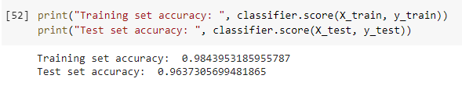
TRAIN THE CLASSIFIER
MultinomialNB:
Probabilistic learning method
Based on Bayes theorem
Calculates the probability of each tag for a given sample and gives the tag with the highest probability as output
Accuracy:
Training set: 98.4%
Test set: 96.37%

Slide 15
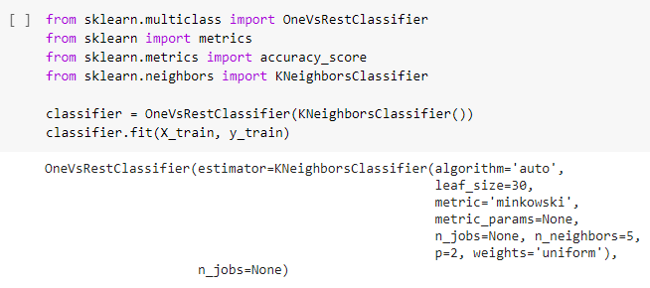
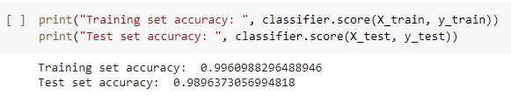
TRAIN THE CLASSIFIER
KneighboursClassifier:
Prediction is made by majority vote of its k nearest neighbours
Basic steps include:
Calculate distance
Find closest neighbours
Vote for labels
Accuracy:
Training set: 99.6%
Test set: 98.9%

Slide 16
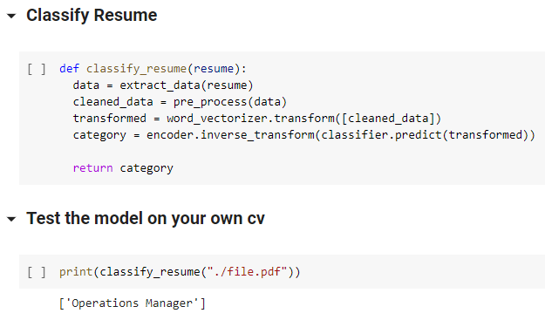
CLASSIFY A RESUME
Extract data
Pre-process data
Vectorize data
Predict category
https://drive.google.com/file/d/15iNZPsvg0ea3kAy1skJdh_NJMDHX_9aD/view?usp=sharing

Slide 17
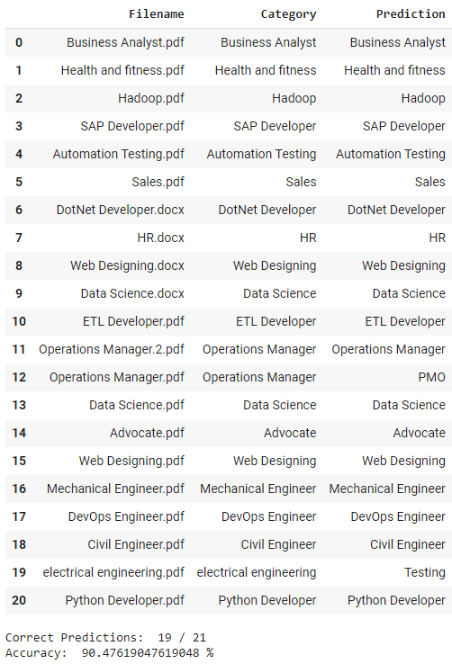
Accuracy on test data
Collected 21 different resumes from the internet
Noted down the category of the resumes
Renamed the files same as their category
Predictions made on each resume
Compared the predictions with the category in filename
Correct predictions: 19 / 21
Accuracy: 90.5 %
https://drive.google.com/drive/folders/1k1zQ_vonJQ2EDvkYxlSS14pUJQ5r5_wU?usp=sharing

Slide 18
INTERNSHIP FEEDBACK
Learned many new concepts related to Natural Language Processing
Developed my first NLP project (CV classification model)
Improved my communication skills
Experienced working in a team
I plan to continue learning more about NLP and work on bigger and more useful projects in future.

Slide 19
REFERENCES
Resume Classification https://colab.research.google.com/drive/1DBMXkC8iJVWyKxLDbdc8kY_jrdzh3v3J?usp=sharing
Dataset
https://www.kaggle.com/gauravduttakiit/resume-dataset
Test resumes https://drive.google.com/drive/folders/1k1zQ_vonJQ2EDvkYxlSS14pUJQ5r5_wU?usp=sharing
Comparative analysis report https://docs.google.com/document/d/1Or-VUPl23fU8gZzyMaX3Rn2kgoV79HX7/edit?usp=sharing&ouid=106394245761577401850&rtpof=true&sd=true

Slide 20
NAME: Maarij Khan Supervisor: Ms. Sahar Arshad Topic: A Question Answering based IR System for legal documents

Slide 21
WORK TILL THE MID-PRESENTATION:
Took FASTAI lectures, and the stanford university lectures.
Took the python for everybody course, and practiced it.
Learnt using Pandas, Numpy and other related python libraries.
Started researching about Natural Language Processing(NLP) techniques and its implementation.
Started practicing, coding and the links were provided in the daily progress report.

Slide 22
IMPLEMENTATION OF MODEL
Using the pre-trained models for project implementation.
Using different datasets to check the accuracy.
Working with transformers of different versions.
Working with different codes, downloaded from github.

Slide 23
Following is the work-flow in detail:
USING DATASETS
Using the pre-trained models downloaded from github and checking the implementation and logics behind.
Downloading the datasets from different sides.
The DATASET used is either BERT or SQuAD(Stanford Question Answering Dataset) .
The datasets include paragraphs, which contains the answers and questions are generated through them.
A Legal Corpus dataset was provided by the supervisor.

Slide 24
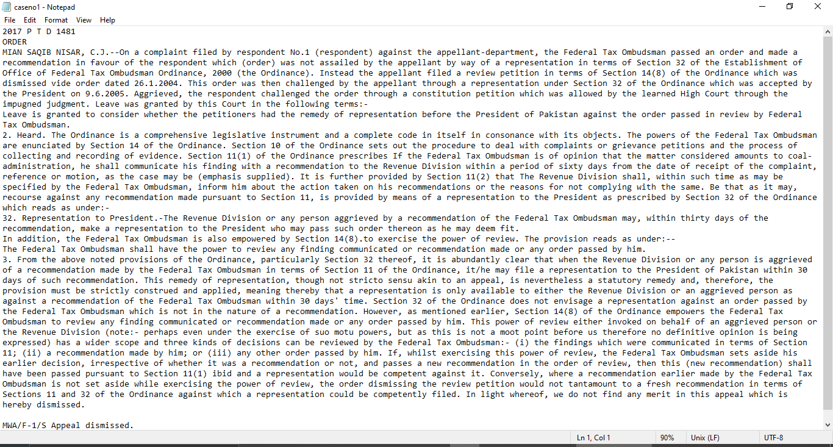
HERE IS A SAMPLE DATA SET:

Slide 25
MODELS
Pre-trained models are used. For implementation “iarfmoose/t5-base-question-generator” is used that works on Transformer 5.
A pre-trained model named “valhalla/t5-base-qg-hl” was also used which works on Transformer 3.
Data is fed into the model. The required results are then produced.
The model generated a question on basis of the context or data given and answers it as well.

Slide 26

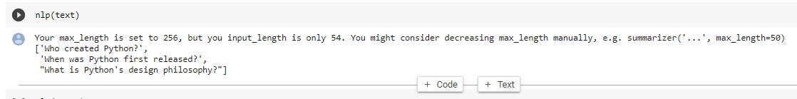
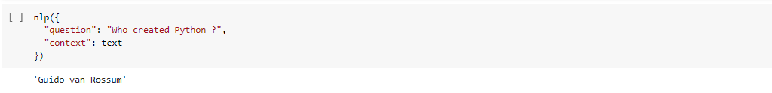
Following steps are involved:
STEP1: Text is fed into the model.
STEP2: Questions are generated based on the text.
STEP3: The questions are answered.

Slide 27
NLTK AND FINE TUNING:
The given dataset is fine-tuned and it is done through the SPACY and NLTK libraries. The required data is then extracted from the whole dataset, which is then converted into the respective vectors by word2vec techniques. Several wok is done on data set and then it is used in the pre-trained model.
LINK
Practice was done to improve the accuracy of pre-trained models.
Here is link to a question-answer generation model:
https://colab.research.google.com/drive/1PSGUx5y3ZLuSFdxVGTYdxuK7Ng5CuC5s?usp=sharing

Slide 28
FEEDBACK ON DLL INTERNSHIP:
>Teamwork and Collaboration
>Workload Management
>Python and its libraries
>NLP first project

Slide 29
Automatic Summarization of Legal Documents
Name: Hassan Bin Ali
Batch: BEE-11-A
Supervisor: Sahar Arshad

Slide 30

Overview
Progress till mid-week presentation
OpenAi’s GPT-2 vs Bert
Summary Using GPT-2
Summary of given case judgements
Rouge Score
Fine Tuning through hyperparameters
NATIONAL UNIVERSITY OF SCIENCE AND TECHNOLOGY

Slide 31
Progress till mid-week presentation
•Fast.ai and Stanford lectures with questionnaire solved.
•Python libraries
•Models like: CNN, RNN, LSTM, Transformer
•Data pre-processing using nltk library
•Extractive Summarizer using nltk and spacy
NATIONAL UNIVERSITY OF SCIENCE AND TECHNOLOGY

Slide 32
GPT-2 VS Bert
GPT-2
Bert
Based on transformer architecture
Decoder blocks of transformer only
Auto-regressive model
Masked self-Attention
Based on transformer architecture
Encoder blocks of transformer only
Auto-Encoder model
Masked Language model
Self-Attention
NATIONAL UNIVERSITY OF SCIENCE AND TECHNOLOGY

Slide 33
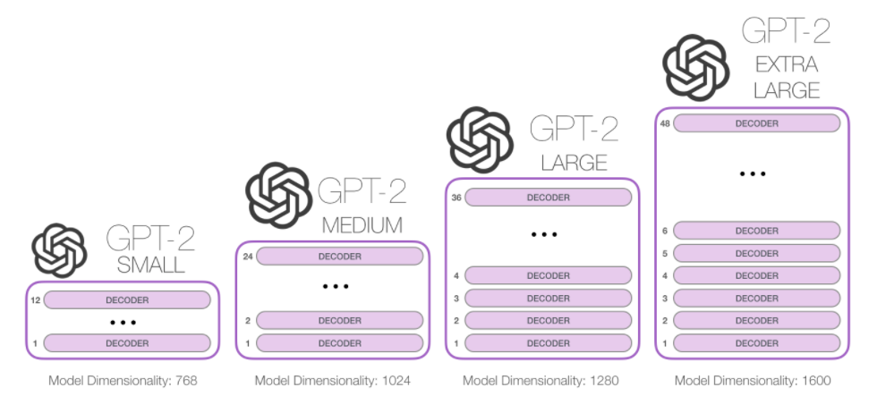
GPT-2 Versions
NATIONAL UNIVERSITY OF SCIENCE AND TECHNOLOGY

Slide 34
Legal Text Summarization using GPT-2
1. Semi Supervised Training
2. Supervised Training
Train unlabeled data
Training on large amount of text
Auto-regressive language models
Fine-Tune for specific task
NATIONAL UNIVERSITY OF SCIENCE AND TECHNOLOGY

Slide 35


Legal Text Summarization using GPT-2
Clustering
(GPT-2)
Summary
Decoder
Decoder
(Decoder)
Feed Forward
Positional Embeddings
Masked Self Attention
Legal Text
Token Embeddings
+
Pre-Processing
NATIONAL UNIVERSITY OF SCIENCE AND TECHNOLOGY

Slide 36
Sample Case Judgement-1
2017 P T D 1481ORDERMIAN SAQIB NISAR, C.J.--On a complaint filed by respondent No.1 (respondent) against the appellant-department, the Federal Tax Ombudsman passed an order and made a recommendation in favour of the respondent which (order) was not assailed by the appellant by way of a representation in terms of Section 32 of the Establishment of Office of Federal Tax Ombudsman Ordinance, 2000 (the Ordinance). Instead the appellant filed a review petition in terms of Section 14(8) of the Ordinance which was dismissed vide order dated 26.1.2004. This order was then challenged by the appellant through a representation under Section 32 of the Ordinance which was accepted by the President on 9.6.2005. Aggrieved, the respondent challenged the order through a constitution petition which was allowed by the learned High Court through the impugned judgment. Leave was granted by this Court in the following terms:-Leave is granted to consider whether the petitioners had the remedy of representation before the President of Pakistan against the order passed in review by Federal Tax Ombudsman.2. Heard. The Ordinance is a comprehensive legislative instrument and a complete code in itself in consonance with its objects. The powers of the Federal Tax Ombudsman are enunciated by Section 14 of the Ordinance. Section 10 of the Ordinance sets out the procedure to deal with complaints or grievance petitions and the process of collecting and recording of evidence. Section 11(1) of the Ordinance prescribes If the Federal Tax Ombudsman is of opinion that the matter considered amounts to coal-administration, he shall communicate his finding with a recommendation to the Revenue Division within a period of sixty days from the date of receipt of the complaint, reference or motion, as the case may be (emphasis supplied). It is further provided by Section 11(2) that The Revenue Division shall, within such time as may be specified by the Federal Tax Ombudsman, inform him about the action taken on his recommendations or the reasons for not complying with the same. Be that as it may, recourse against any recommendation made pursuant to Section 11, …
NATIONAL UNIVERSITY OF SCIENCE AND TECHNOLOGY

Slide 37
Reference Summary
2017 P T D 1481[Supreme Court of Pakistan]Present Mian Saqib Nisar, C.J., Umar Ata Bandial and Maqbool Baqar, JJFEDERATION OF PAKISTAN through Secretary Revenue Division, Islamabad and others Versus Messrs SAHIB JEE and others Civil Appeal No.1074 of 2009, decided on 19th January, 2017.(Against the judgment dated 20-3-2009 of the Lahore High Court, Lahore passed in W.P. No.11983 of 2005).(a) Establishment of Office of Federal Tax Ombudsman Ordinance (XXXV of 2000)-------Ss. 11 & 32---Reference to the President against recommendation of Ombudsman---Scope---When the Revenue Division or any person was aggrieved of a recommendation made by the Federal Tax Ombudsman in terms of S.11 of the Establishment of Office of Federal Tax Ombudsman Ordinance, 2000, ithe may file a representation to the President of Pakistan within 30 days of such recommendation---Said remedy of representation, though not stricto sensu akin to an appeal, was nevertheless a statutory remedy and, therefore, the provision must be strictly construed and applied, meaning thereby that a representation was only available to either the Revenue Division or an aggrieved person as against a recommendation of the Federal Tax Ombudsman within…
GPT2-generated Summary
2017 P T D 1481
ORDER
MIAN SAQIB NISAR, C.J.--On a complaint filed by respondent No.1 (respondent) against the appellant-department, the Federal Tax Ombudsman passed an order and made a recommendation in favour of the respondent which (order) was not assailed by the appellant by way of a representation in terms of Section 32 of the Establishment of Office of Federal Tax Ombudsman Ordinance, 2000 (the Ordinance). This order was then challenged by the appellant through a representation under Section 32 of the Ordinance which was accepted by the President on 9.6.2005. It is further provided by Section 11(2) that The Revenue Division shall, within such time as may be specified by the Federal Tax Ombudsman, inform him about the action taken on his recommendations or the reasons for not complying with the same. In addition, the Federal Tax Ombudsman is also empowered by Section 14(8).to exercise the power of review. Conversely, where a recommendation earlier made by the Federal Tax Ombudsman is not set aside while exercising the power of review, the order dismissing the review petition would not tantamount to a fresh recommendation in terms of Sections 11 and 32 of the Ordinance…
NATIONAL UNIVERSITY OF SCIENCE AND TECHNOLOGY

Slide 38
Sample Case Judgement-2
2016 S C M R 1420JUDGMENTFAISAL ARAB, J.---In the bye-election that was held for the Punjab Assembly constituency PP-240 D.G. Khan-I, the appellant was declared returned candidate. Her election was challenged by losing candidate i.e. respondent No. 1 through an election petition filed in the Election Tribunal, Bahawalpur and D.G. Khan Divisions under section 52 of the Representation of the People Act, 1976. Corrupt and illegal practices were alleged. During pendency of the election petition, the respondent No. 1 moved an application under section 76A of the Representation of the People Act, 1976. This provision of law entrusts the Election Tribunal with additional power to declare an election of the returned candidate void if any material from any source or information is laid before it that the returned candidate had inter alia submitted a false or incorrect statement of assets and liabilities of his own or his spouse or his dependents. Before the Tribunal though the allegations of corrupt practices could not be established however while hearing the application filed under Section 76A of the Representation of the People Act, 1976 it transpired that the respondent No. 1 in her nomination form failed to disclose properties such as (i) land measuring 448 kanals 4 marlas situated in Moza Bairoot Mandhawani, Tribal District Khazi Khan (owned by husband of the appellant) and (ii) land measuring 263 kanals 14 marlas situated in Moza Bait Wasava Khan Wala Tehsil and District Layyah and (iii) land measuring 13 kanals 16 marlas situated in Bait Wasava Kalroo Tehsil and District Layyah, and (iv) land measuring 77 acres situated in Mouza Khanwala, Wasavewala, Layyah (owned by the appellant) were not disclosed in the nomination papers. Consequently, the election of the appellant was declared void and fresh elections were ordered to be held in the constituency. Against such decision, the present appeal has been filed.2. Learned counsel for the appellant contended that section 76A of Representation of the People Act, 1976 is contrary to the provisions of Article 225 of the Constitution. He submitted that according to Article 225 of the Constitution, no election to a House or Provincial Assembly can be called in question except by election petition and in the election petition the respondent No. 1 failed in establishing plea of corrupt and illegal election practices. …
NATIONAL UNIVERSITY OF SCIENCE AND TECHNOLOGY

Slide 39
Reference Summary
2016 S C M R 1420[Supreme Court of Pakistan]Present: Anwar Zaheer Jamali, C.J., Sh. Azmat Saeed and Faisal Arab, JJMs. SHAMUNA BADSHAH QAISARANI---Appellant Versus Khuwaja MUHAMMAD DAWOOD and others---Respondents Civil Appeal No. 1628 of 2014, decided on 9th May, 2016.(On appeal against the judgment dated 19-11-2014 passed by Election Tribunal, Bahawalpur and D.G. Khan Divisions in Election Petition No. 13 of 2013)(a) Representation of the People Act (LXXXV of 1976)--- ----S. 76A---Non-disclosure/incorrect disclosure of properties belonging to returned candidate and her spouse---Election of returned candidate declared as void---Fact that certain properties were not disclosed in the nomination papers was not denied by the returned candidate in the present case---Plea by returned candidate that subject properties were not disclosed as they were transferred to her brother, did not find support from the revenue record---Only in an affidavit it had been disclosed that the properties had been transferred to her brothers---At the time of filing of the nomination papers these properties were admittedly in the name of the returned candidate and her spouse in the revenue record---Election Tribunal, in such circumstances, had rightly declared …
GPT2-generated Summary
2016 S C M R 1420
JUDGMENT
FAISAL ARAB, J.---In the bye-election that was held for the Punjab Assembly constituency PP-240 D.G. Khan-I, the appellant was declared returned candidate. Her election was challenged by losing candidate i.e. respondent No. 1 through an election petition filed in the Election Tribunal, Bahawalpur and D.G. Khan Divisions under section 52 of the Representation of the People Act, 1976. Consequently, the election of the appellant was declared void and fresh elections were ordered to be held in the constituency. He submitted that in the circumstances the Election Tribunal ought not to have entertained the application filed under section 76A of Representation of the People Act, 1976. It is an admitted position that only in an affidavit it has been disclosed that the properties have been transferred to her brothers.
NATIONAL UNIVERSITY OF SCIENCE AND TECHNOLOGY

Slide 40
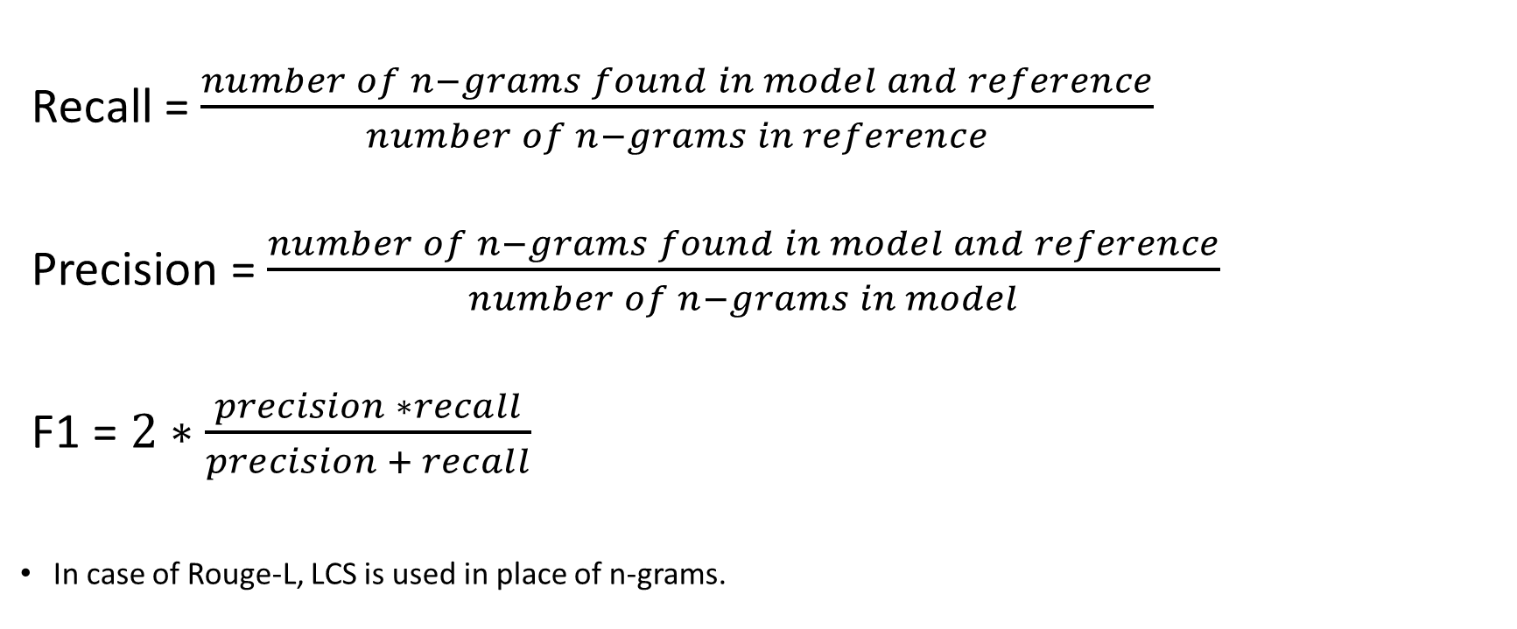
Rouge Score Calculation
NATIONAL UNIVERSITY OF SCIENCE AND TECHNOLOGY

Slide 41
Rouge Score (GPT2-medium)
File name | Rouge-1(F1) | Rouge-1(P) | Rouge-1(R) | Rouge-2(F1) | Rouge-2(P) | Rouge-2(R) | Rouge-L(F1) | Rouge-L(P) | Rouge-L(R)
caseno1.txt | 0.327354 | 0.603306 | 0.424419 | 0.176 | 0.375 | 0.239564 | 0.286996 | 0.528926 | 0.372093
caseno2.txt | 0.41349 | 0.381081 | 0.396624 | 0.259136 | 0.223496 | 0.24 | 0.387097 | 0.356757 | 0.371308
caseno3.txt | 0.238636 | 0.707865 | 0.356941 | 0.128257 | 0.520325 | 0.205788 | 0.238636 | 0.707865 | 0.356941
caseno4.txt | 0.292517 | 0.325758 | 0.308244 | 0.118343 | 0.140515 | 0.12848 | 0.261905 | 0.291667 | 0.275986
caseno5.txt | 0.3375 | 0.312139 | 0.324324 | 0.158607 | 0.135762 | 0.146298 | 0.31875 | 0.294798 | 0.306306
caseno6.txt | 0.310458 | 0.360531 | 0.333626 | 0.15834 | 0.176582 | 0.166964 | 0.281046 | 0.326376 | 0.302019
caseno7.txt | 0.323009 | 0.337963 | 0.330317 | 0.101156 | 0.11254 | 0.106545 | 0.274336 | 0.287037 | 0.280543
caseno8.txt | 0.365998 | 0.41555 | 0.389203 | 0.199165 | 0.211795 | 0.205286 | 0.345927 | 0.392761 | 0.367859
caseno9.txt | 0.251497 | 0.494118 | 0.333333 | 0.127013 | 0.276265 | 0.17402 | 0.230539 | 0.452941 | 0.305556
caseno10.txt | 0.343396 | 0.348659 | 0.346008 | 0.183258 | 0.178414 | 0.180804 | 0.328302 | 0.333333 | 0.330798
NATIONAL UNIVERSITY OF SCIENCE AND TECHNOLOGY

Slide 42
Rouge Score (GPT2-large)
File name | Rouge-1(F1) | Rouge-1(P) | Rouge-1(R) | Rouge-2(F1) | Rouge-2(P) | Rouge-2(R) | Rouge-L(F1) | Rouge-L(P) | Rouge-L(R)
caseno1.txt | 0.331839 | 0.587302 | 0.424069 | 0.184 | 0.359375 | 0.243386 | 0.29148 | 0.515873 | 0.372493
caseno2.txt | 0.375367 | 0.335079 | 0.35408 | 0.199336 | 0.166898 | 0.181681 | 0.340176 | 0.303665 | 0.320885
caseno3.txt | 0.314394 | 0.557047 | 0.401937 | 0.158317 | 0.369159 | 0.221599 | 0.30303 | 0.536913 | 0.387409
caseno4.txt | 0.336735 | 0.362637 | 0.349206 | 0.120316 | 0.139908 | 0.129374 | 0.312925 | 0.336996 | 0.324515
caseno5.txt | 0.35 | 0.302703 | 0.324638 | 0.172147 | 0.136713 | 0.152397 | 0.31875 | 0.275676 | 0.295652
caseno6.txt | 0.359477 | 0.354267 | 0.356853 | 0.208298 | 0.193244 | 0.200489 | 0.318627 | 0.31401 | 0.316302
caseno7.txt | 0.336283 | 0.356808 | 0.346241 | 0.132948 | 0.139818 | 0.136296 | 0.314159 | 0.333333 | 0.323462
caseno8.txt | 0.362456 | 0.347285 | 0.354708 | 0.187835 | 0.177066 | 0.182292 | 0.345927 | 0.331448 | 0.338533
caseno9.txt | 0.227545 | 0.452381 | 0.302789 | 0.134168 | 0.308642 | 0.187032 | 0.218563 | 0.434524 | 0.290837
caseno10.txt | 0.396226 | 0.377698 | 0.38674 | 0.262443 | 0.218456 | 0.238438 | 0.384906 | 0.366906 | 0.375691
NATIONAL UNIVERSITY OF SCIENCE AND TECHNOLOGY

Slide 43
GPT2-medium: Results
C#25
C#28
C#37
C#12
C#37
C#28
NATIONAL UNIVERSITY OF SCIENCE AND TECHNOLOGY

Slide 44
GPT2-large: Results
C#38
C#38
C#38
C#66
C#17
C#66
C#17
C#17
C#37
C#37
C#37
C#12
C#37
C#12
C#37
C#37
C#14
NATIONAL UNIVERSITY OF SCIENCE AND TECHNOLOGY

Slide 45
Bert(Base) Vs GPT-2(Med) Vs XLNet
C#3
C#38
C#43
C#25
C#66
C#27
C#28
C#63
C#37
C#14
C#28
C#28
C#37
C#28
NATIONAL UNIVERSITY OF SCIENCE AND TECHNOLOGY

Slide 46
Bert(Base) Vs GPT-2(Med) Vs XLNet
C#3
C#38
C#3
C#27
C#33
C#28
C#37
C#28
C#37
C#37
C#28
C#12
C#37
C#12
NATIONAL UNIVERSITY OF SCIENCE AND TECHNOLOGY

Slide 47
Fine-Tuning (hyperparameters)
Fine-Tuned hyperparameters
Selected Hyperparameters
Minimum length: Length of each sentence in GPT2 summary
Ratio: GPT2 summary to Reference summary
Number of Sentences: In GPT2 summary
Minimum length: 100
Ratio: 0.35
Number of Sentences: 14
NATIONAL UNIVERSITY OF SCIENCE AND TECHNOLOGY

Slide 48
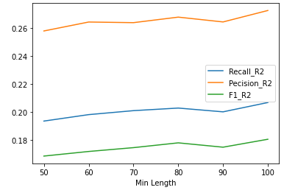
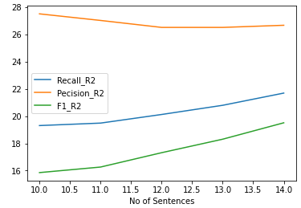
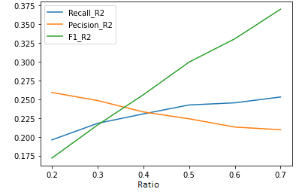
Fine-Tuning (hyperparameters)
NATIONAL UNIVERSITY OF SCIENCE AND TECHNOLOGY

Slide 49
Results of Fine-Tuning
0.264
0.273
0.415
0.413
0.241
0.232
0.369
0.350
0.335
0.198
0.297
0.171
NATIONAL UNIVERSITY OF SCIENCE AND TECHNOLOGY

Slide 50
Outcomes
Reference Summaries contain some extra information (Appellant names, article numbers, roman digis etc.) which is not present in case judgement, so rouge score of GPT2 summaries is reduced when compared to these reference summaries.
•Fine tuning GPT-2 through hyperparameters helped improve the quality of system generated summaries.
References
https://medium.com/analytics-vidhya/text-summarization-using-bert-gpt2-xlnet-5ee80608e961
https://jalammar.github.io/illustrated-gpt2/
https://blog.paperspace.com/generating-text-summaries-gpt-2/
NATIONAL UNIVERSITY OF SCIENCE AND TECHNOLOGY

Slide 51
Feedback On DLL-internship
Skills Learnt during this internship:
Teamwork
Self learning and implementing machine learning model.
Exploring and utilizing online resources (Colab, Github etc.)
Python Skills
Links:
https://colab.research.google.com/drive/1FcJEKtCzEXaoA2hP7ItPRTId5vADFYRi?usp=sharing (GPT2 summaries and rouge score)
https://colab.research.google.com/drive/1RCgLnyFpGF6rEN03CLUue8B-v2QW1dB0?usp=sharing (Bert summaries and rouge score)
https://colab.research.google.com/drive/19DjX5XiVv-W5OkohiFWBmoiO7Hkwt0d4?usp=sharing (XLNet summaries and rouge score)
https://colab.research.google.com/drive/1y10o-qSUUF-472kLiGtKKsdVFIW_hzSg?usp=sharing (Fine Tuning through hyperparameters)
https://colab.research.google.com/drive/13n5fj3gtLKqqQjstsKyK98u9yQPwHdm8?usp=sharing (Final GPT2 Summaries with improved score)
https://drive.google.com/file/d/1aIyvlC2VAzyH8pAWp-gTgLWAVLWPUpdX/view?usp=sharing (Rouge Score (GPT2-medium) for all judgements)
https://drive.google.com/file/d/1DMYqiX09CnTmb6Uhvujw10R-oPR-P7TE/view?usp=sharing (Comparative analysis report)
NATIONAL UNIVERSITY OF SCIENCE AND TECHNOLOGY

Slide 52
Legal Text Summarization using XLNET
Supervisor: Sahar Arshad
Internee: Amna Ahmad
BESE11-A
NATIONAL UNIVESITY OF SCIENCE AND TECHNOLOGY

Slide 53
Overview
GPT-2 vs Bert vs XLNET
Summary Using XLNET
Summary of given case judgements
Rouge Score (Graphs)
Fine Tuning through hyperparameters
Outcomes
Feedback
NATIONAL UNIVERSITY OF SCIENCE AND TECHNOLOGY

Slide 54
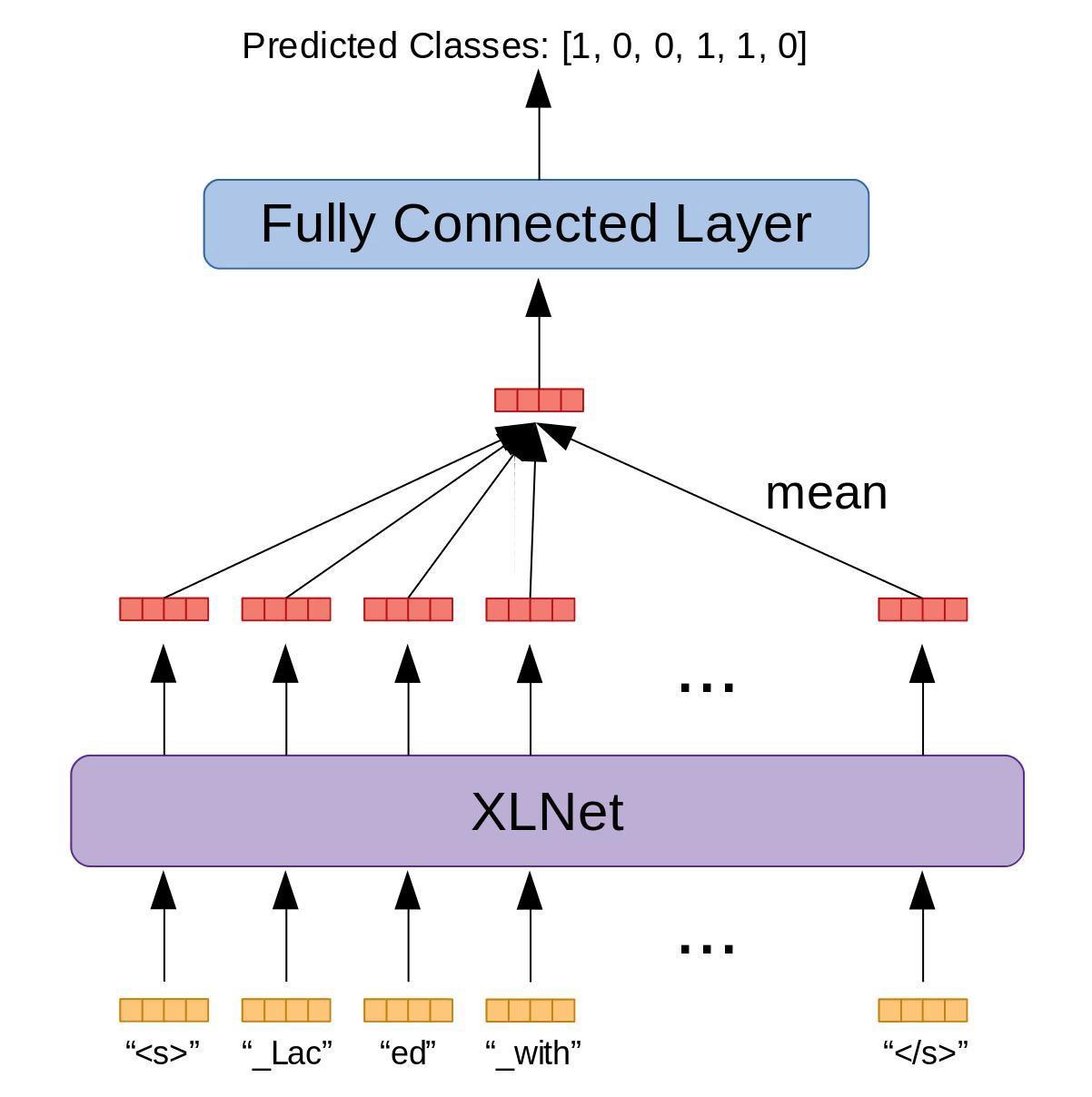
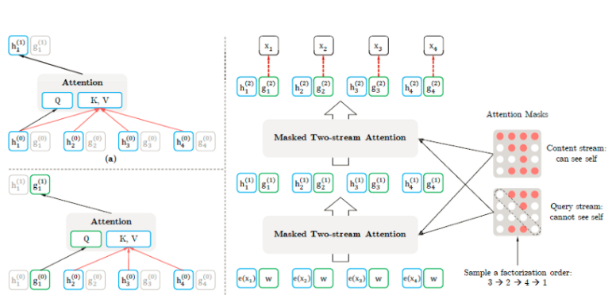
Legal Text Summarization using XLNET
NATIONAL UNIVESITY OF SCIENCE AND TECHNOLOGY

Slide 55
Progress till mid-week presentation
•Fast.ai and Stanford lectures with questionnaire solved.
•Python libraries
•Models like: CNN, RNN, LSTM, Transformer
•Data pre-processing using nltk library
•Extractive Summarizer using nltk and spacy
NATIONAL UNIVERSITY OF SCIENCE AND TECHNOLOGY

Slide 56
GPT-2 VS Bert Vs XLNET
GPT-2
Bert
XLNET
Based on transformer architecture
Decoder blocks of transformer only
Auto-regressive model
Masked self-Attention
Based on transformer architecture
Encoder blocks of transformer only
Auto-Encoder model
Masked Language model
Self-Attention
large bidirectional transformer
uses improved training methodology
more computational power
NATIONAL UNIVERSITY OF SCIENCE AND TECHNOLOGY

Slide 57
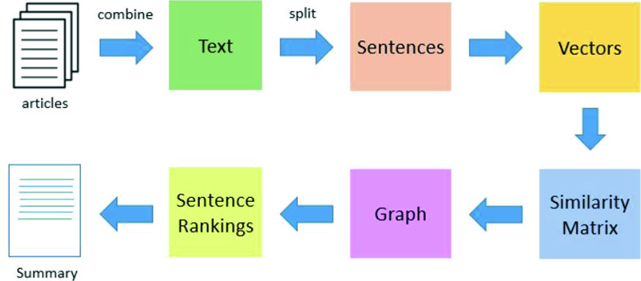
Legal Text Summarization using XLNET
NATIONAL UNIVESITY OF SCIENCE AND TECHNOLOGY

Slide 58
Rouge Score Calculation
NATIONAL UNIVERSITY OF SCIENCE AND TECHNOLOGY

Slide 59
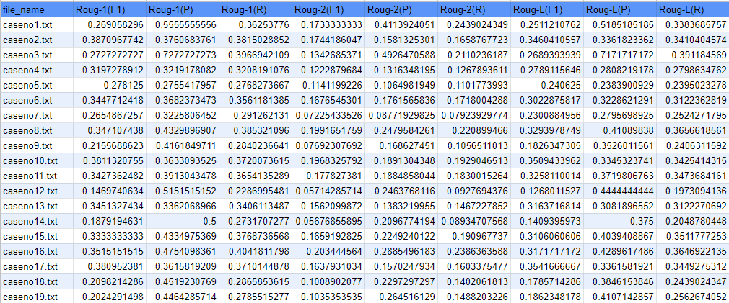
Rouge Score (XLNET)
NATIONAL UNIVERSITY OF SCIENCE AND TECHNOLOGY

Slide 60
Rouge Score (XLNET)
Rouge 1-(F1) Rouge1(P) Rouge1-(R)
NATIONAL UNIVERSITY OF SCIENCE AND TECHNOLOGY

Slide 61

Rouge Score (XLNET)
Rouge2(F1) Rouge2(P) Rouge 2(R)
NATIONAL UNIVERSITY OF SCIENCE AND TECHNOLOGY

Slide 62
Rouge Score (XLNET)
RougeL(F1) RougeL(P) Rouge L(R)
NATIONAL UNIVERSITY OF SCIENCE AND TECHNOLOGY

Slide 63
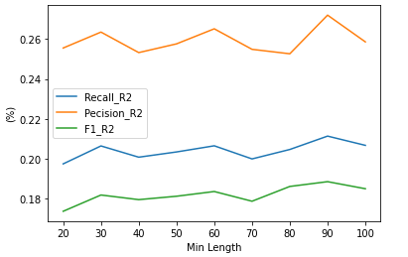
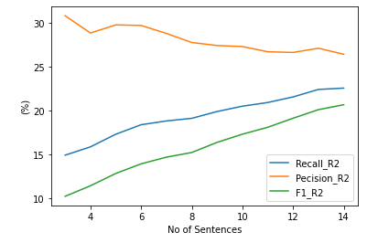
Fine-Tuning (hyperparameters)
NATIONAL UNIVERSITY OF SCIENCE AND TECHNOLOGY

Slide 64
Outcomes
Reference Summaries contain some extra information.
effective in several downstream NLP tasks such as sentiment analysis.
allows context to consists of tokens from both left and right, capturing the bidirectional context, making it a generalized order-aware AR language model.
Fine tuning on task-specific data (or fine tuning through hyperparameters can help improve quality of system generated summaries to produce a better result)
References
https://github.com/zihangdai/xlnet
https://medium.com/syncedreview/cmu-google-xlnet-tops-bert-achieves-sota-results-on-18-nlp-tasks-66f7022f34f5
https://www.kdnuggets.com/2019/07/xlnet-outperforms-bert-several-nlp-tasks.html
NATIONAL UNIVERSITY OF SCIENCE AND TECHNOLOGY

Slide 65
Feedback On DLL-internship
Skills Learnt during this internship:
Python
Team management
Learning new models
Handling workload
Working on Github and collab
Links:
https://colab.research.google.com/drive/1FcJEKtCzEXaoA2hP7ItPRTId5vADFYRi?usp=sharing (GPT2 summaries and rouge score)
https://colab.research.google.com/drive/1RCgLnyFpGF6rEN03CLUue8B-v2QW1dB0?usp=sharing (Bert summaries and rouge score)
https://colab.research.google.com/drive/19DjX5XiVv-W5OkohiFWBmoiO7Hkwt0d4?usp=sharing (XLNet summaries and rouge score)
https://colab.research.google.com/drive/1GnzzptjGQsMxLfE9xtc5WWEHwCXGa1sV?usp=sharing#scrollTo=DXedmDt-kFsi(Fine Tuning through hyperparameters
Comparison Report: https://drive.google.com/file/d/1DMYqiX09CnTmb6Uhvujw10R-oPR-P7TE/view?usp=sharing)
NATIONAL UNIVERSITY OF SCIENCE AND TECHNOLOGY

